Slide 1
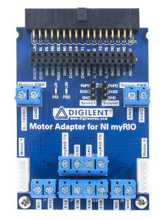
+
-

Slide 2
9 sub pinout
1
2
3
4
5
1. M0+ (motor drive board)
2. GND (myRIO port C)
3. AI 1+ (myRIO port C C)
4. AI 1- (myRIO port C C)
5. AI 0+ (myRIO port C C)
6. M0- (Motor drive board)
7. +5V (myRIO port C C)
8. Not connected
9. AI 0- (myRIO port C C)
6
7
8
9

Slide 3
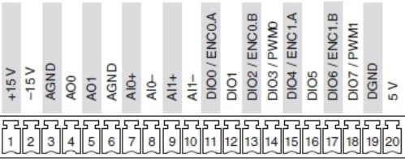
1. M0+ (motor drive board)
2. GND (myRIO port C)
3. AI 1+ (myRIO port C)
4. AI 1- (myRIO port C)
5. AI 0+ (myRIO port C)
6. M0- (Motor drive board)
7. +5V (myRIO port C)
8. Not connected
9. AI 0- (myRIO port C)
1
2
3
4
5
6
7
8
9

